Slide 1
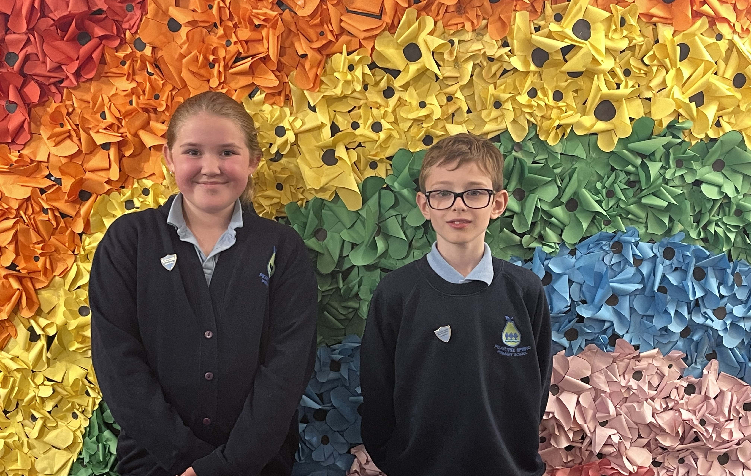
Our newly appointed head boy and head girl cordially invite you to join them for
Coffee and Cake.
Friday 27th September 2024
from 9am to 10am in the Deli.
Donations of cakes are warmly welcome – please give these to the class teacher on Thursday 26th September 2024.
Can’t join us?
Come and say hi and buy a cake at the end of the day. Cakes will be sold on the Key Stage 2 playground from 3.15pm.
Help us raise money for

