Slide 1
My constellation is a remake of a smiley face like this:
I hope you like my remake of a face, out of five what would you rate my picture(I would like the truth please)
My Constellation

Slide 2
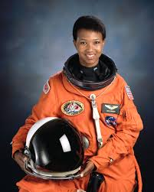
Mae Jemison was born on the 17th of October 1956 and died at the age of 66
Mae Jemison’s dream was to be an astronaut and though many people judged her because of her skin colour she still made it up into space!
Mae had several jobs, in 1981 she worked at Weill Medical College, in 1977 she worked at Stanford Engineering and in 1973 Mae worked at Morgan Park High School.

Slide 3
QUIZ TIME!!!!!!!!!!!!!
CLICK ON THE FLAPS TO SEE THE ANSWERS
When was Mae Jemison born?
How many jobs did Mae Jemison have?
Mae was born on the 17th of october 1956
Mae had 3 jobs
What was Mae Jemison’s dream?
Mae’s dream was to become an astronaut

